Slide 1

Predicting Heart Disease with Different Machine Learning Techniques
By:
Anabel Aguilar Ramirez
Agata Fietko
Tiffany Cerny-Czykier
Business Analytics Capstone

Slide 2
INTRODUCTION
Heart disease remains one of the leading causes of mortality worldwide, making early detection and prevention strategies critical for improving health outcomes. There are different conditions that can affect the heart, including coronary artery disease, arrhythmias, congenital heart defects, among others. The complexity of heart disease, combined with the variety of risk factors such as age, gender, blood pressure, cholesterol levels, and lifestyle choices makes it a challenging condition to predict and manage effectively. This project aims to utilize different machine learning techniques to potentially predict the presence of heart disease in patients, thereby facilitating early intervention and increasing the chances of saving lives.

Slide 3
DATA DESCRIPTION
This dataset compiled in 1988 was obtained from the Website Kaggle, it encompasses information from four distinct databases: Cleveland, Hungary, Switzerland, and Long Beach V. The dataset includes a total of 303 observations, each representing a different patient profile, with 14 attributes:
Age: Numerical, indicating the age of the patient.
Sex: Categorical, with 1 representing male and 0 female.
CP: Categorical, encoded as 1 to 4, each number representing a different type of chest pain where 0: Typical Angina, 1: Atypical Angina, 2: Non-anginal Pain, and 3: Asymptomatic
trtbps: Numerical, the patient's resting blood pressure in mm Hg at admission to the hospital.
Chol: Numerical, the patient's cholesterol measurement in mg/dl.
fbs: Categorical, where 1 indicates a fasting blood sugar greater than 120 mg/dl, and 0 otherwise.
restECG: Categorical, with values indicating the Resting Electrocardiographic Results as 0: Normal, 1: Abnormality, 2: Hypertrophy based on Estes' criteria.
thalachh: Numerical, the maximum heart rate achieved by the patient.
exng: Categorical, where 1 indicates the presence of angina induced by exercise, and 0 indicates no angina.
Oldpeak: Numerical, the ST depression induced by exercise relative to rest.
slp: Categorical, with values representing the slope of the peak exercise ST segment where 0: Upsloping, 1: Flat, and 2: Downsloping.
caa: Numerical, indicating the number of major vessels colored by fluoroscopy.
thall: Categorical, with values indicating different types of thalassemia as 0: Normal, 1: Fixed Defect, and 2: Reversible Defect.
Output: Categorical, indicating the presence (1) or absence (0) of heart disease (target). It is the target variable.

Slide 4

FINDINGS & ANALYSIS

Slide 5
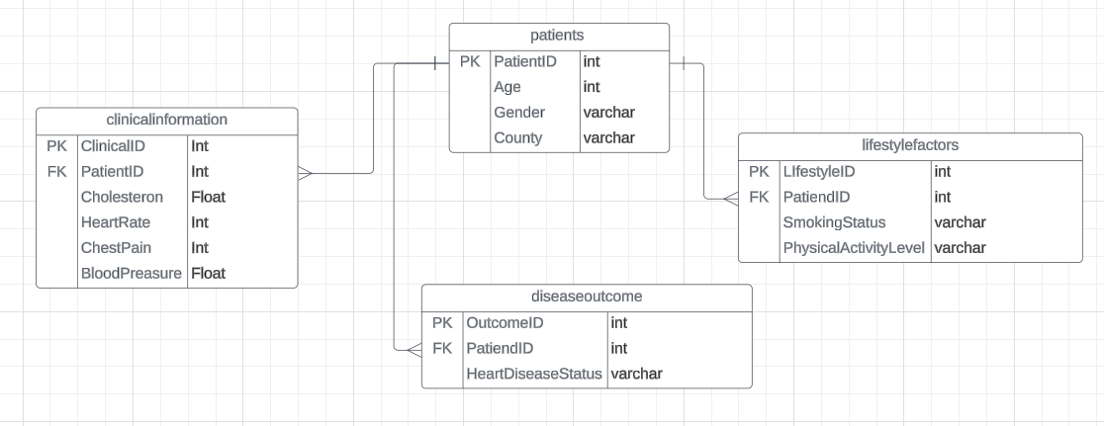
DATABASE MANAGEMENT SYSTEMS
The subsystem Heart Disease Prediction & Management System helps with the tracking of patient demographics, clinical data, lifestyle factors, and disease outcomes.
The ERD contains four tables.
The patient table serves as the central hub, linking to clinicalInformation, lifestyleFactors, and diseaseOutcome tables
One to many relationships.
The FK for these tables are PatientID and each table has different a PK.
ERD Design

Slide 6
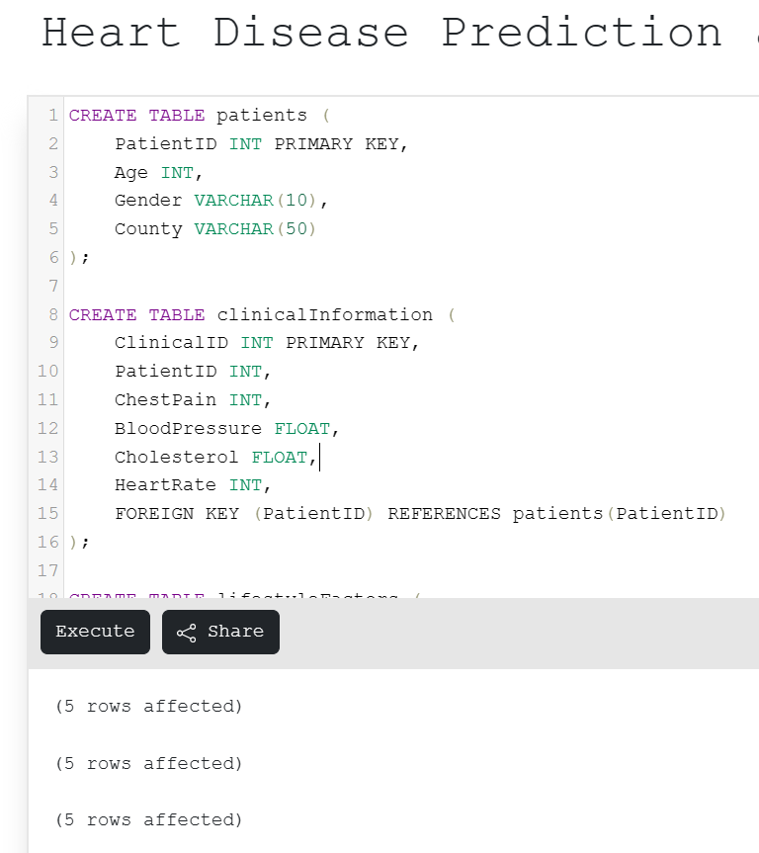
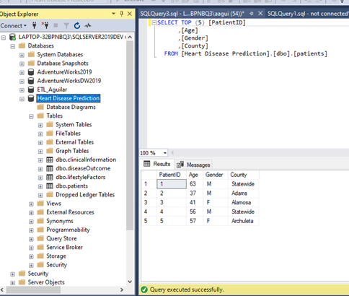
DATABASE MANAGEMENT SYSTEMS (CONTINUED)
SQL Fiddle
Microsoft SQL Server Management Studio

Slide 7
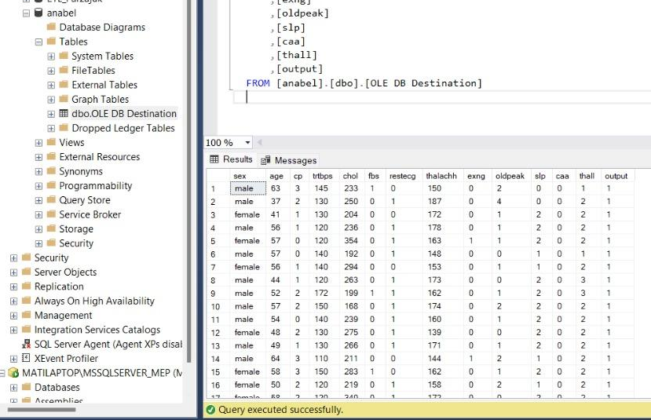
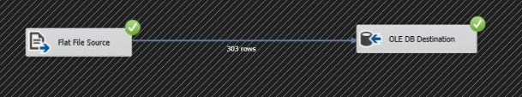
BUSINESS DATA WAREHOUSING
By using ETL processes in data warehousing we stored the data in a structured way to ensure that it is properly prepared, cleaned, and loaded into a the database previously created for further analysis and reporting.
Once configured, ETL processes can be automated to run at scheduled intervals, reducing manual effort and ensuring data freshness. These will make a huge positive impact to on the heart disease prediction since the access to records will be faster and better.
ETL PROCESS

Slide 8
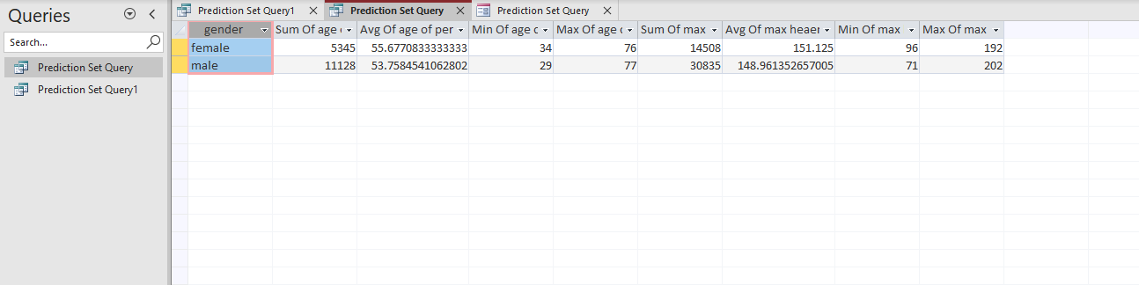
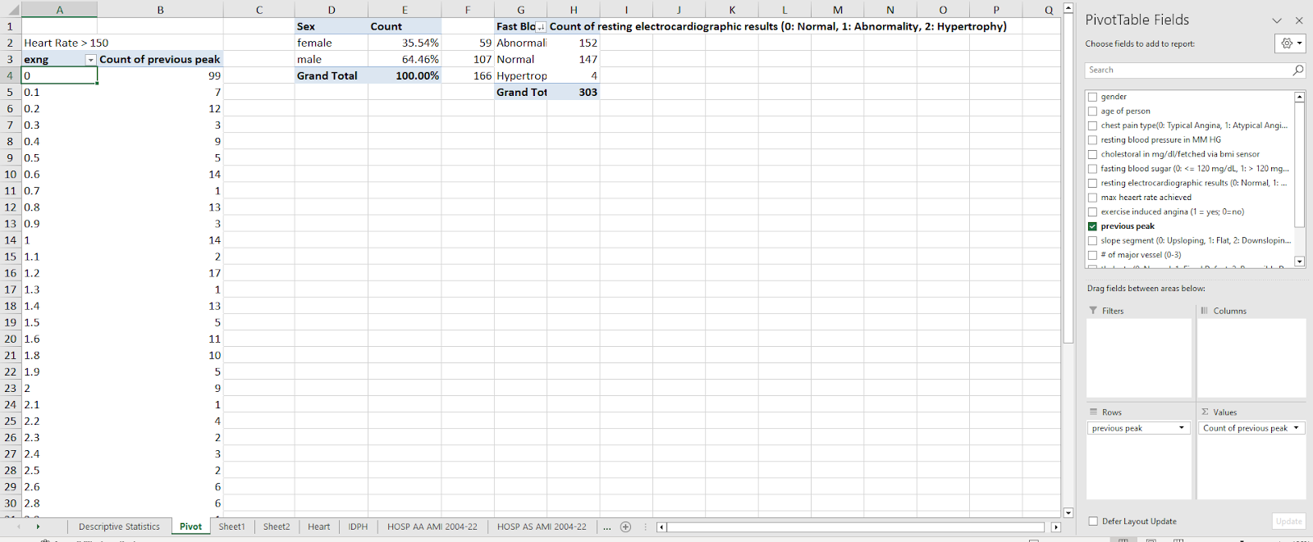
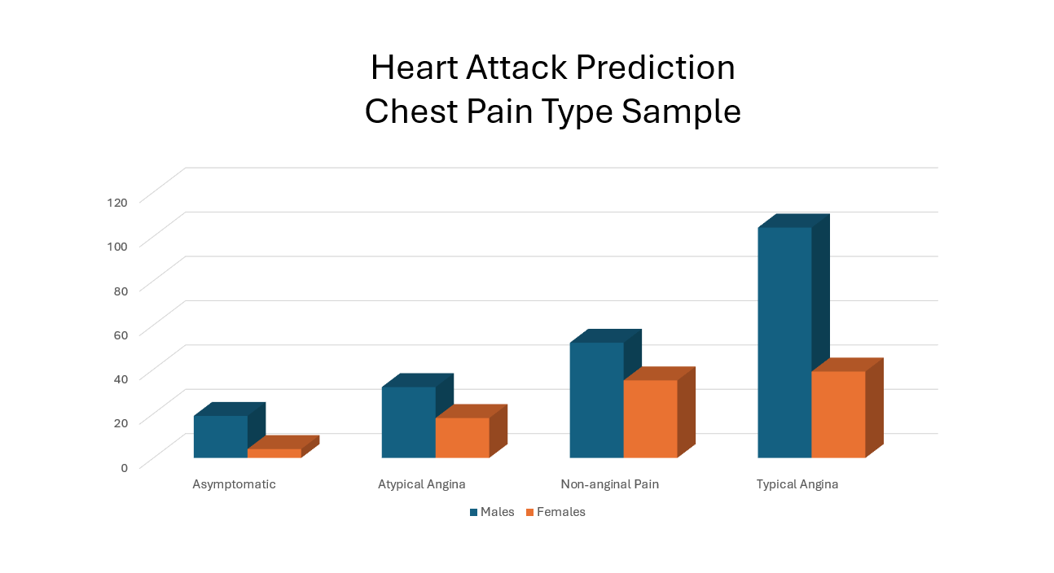
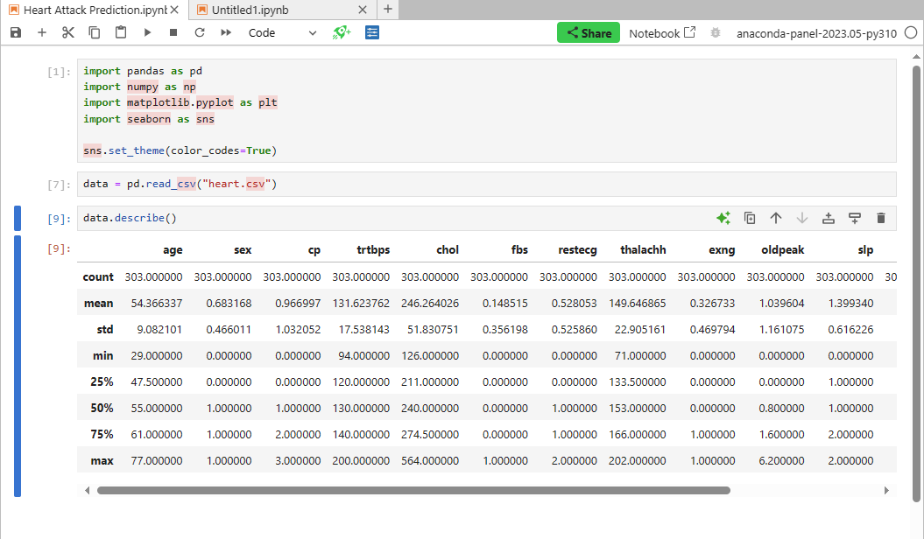
BUSINESS INFORMATION SYSTEMS -Elective
Information systems allow us to collect, store, display and process information. In our analysis the data has been stored in Microsoft Excel, Python, SQL, Weka, Microsoft Access and PowerPoint

Slide 9
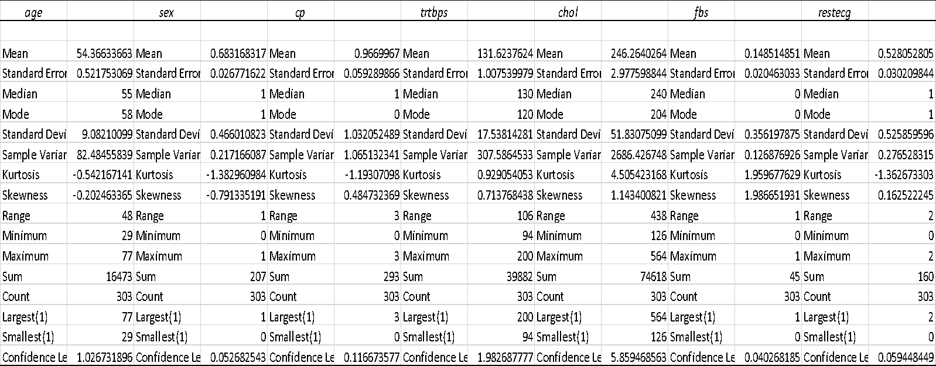
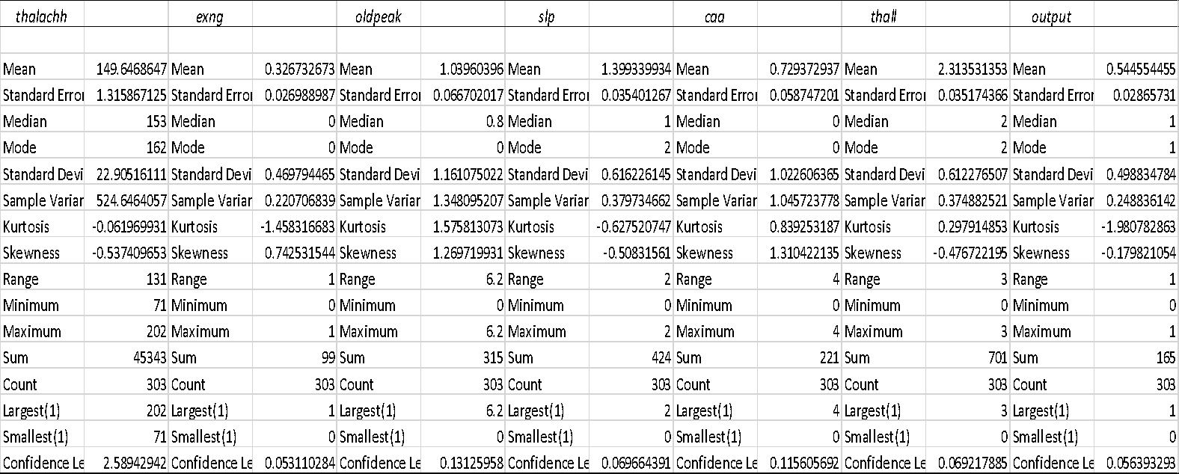
DECISION SCIENCE/BUSINESS STATISTICS
Descriptive statistics were used to gather quantitative measurements to analyze each of the 14 attributes and summarize their values. The measurements include the distribution, central tendency and variability or dispersion.
Cholesterol (Chol) > 200mg puts you at a higher risk for a heart attack. In our dataset the average cholesterol level was 246.26 with the highest number at 564 (driving skewness of 1.143) which is more than twice the number that puts you at higher risk. A range in level from as low as 126 to 564. Frequency Distribution 100-199 count 50, 200-299 count 209, 300-399 count 40, 400 to 499 count 3 and >500 is 1
Max Heart Rate (thalachh) ranges from largest at 202 to smallest at 71. The average max heart rate in our sample is 149 with a standard deviation of 22.90. The data has a skewness of -0.54 with a mode at 162. 85% of the heart rates > 150 had <=120mg fasting blood sugar level.

Slide 10
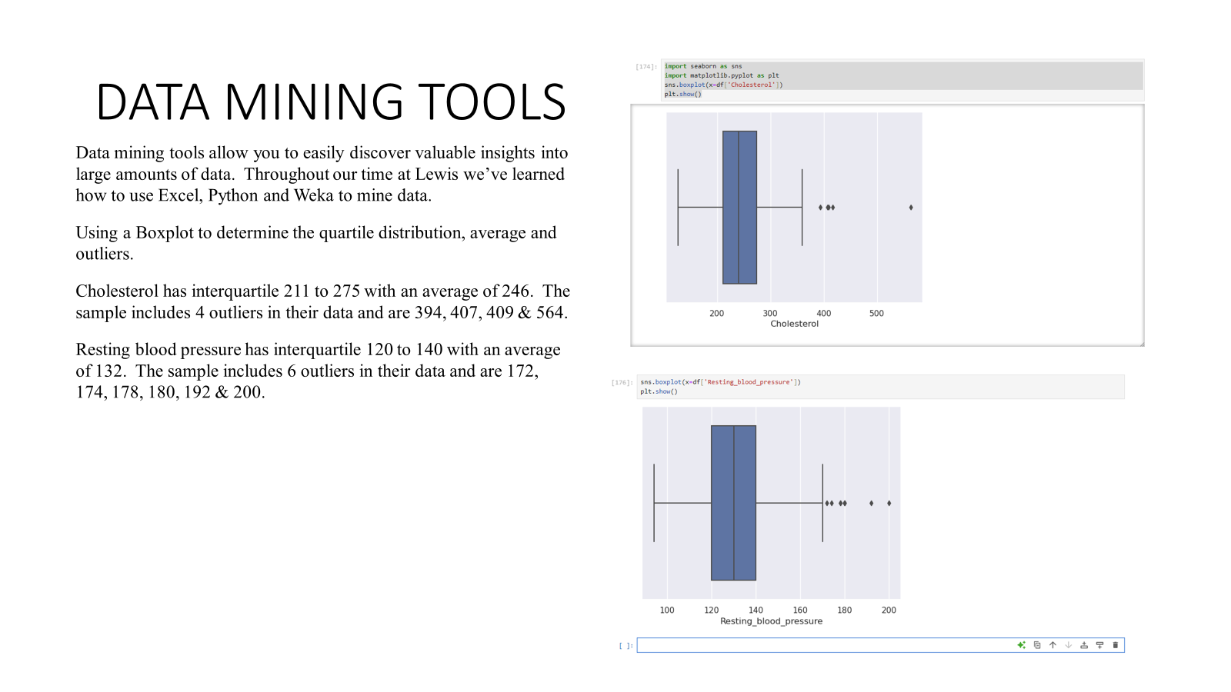

Slide 11
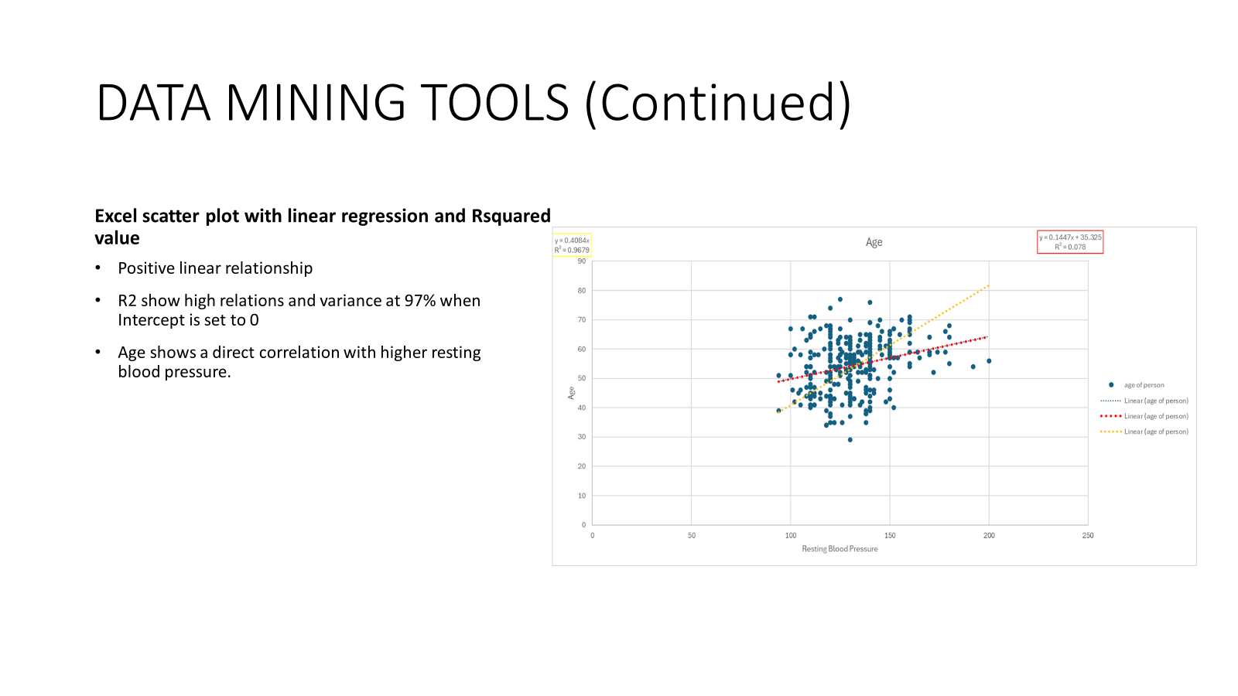

Slide 12
BUSINESS INTELLIGENCE
Cost sensitivity scenario:
From a hospital perspective, predicting the outcome of potential heart attacks in patients. The hospital wants to minimize the amount of heart attacks by being able to predict them or potentially predict them and take steps to prevent them.
1. | Classifier 1: Logistic |  |  | Classifier 2 : J48
 | Default | weight =2 | weight =3 | Default | weight =2 | weight =3
Accuracy | 82.2% | 82.8 | 81.5 | 78.6% | 81.8% | 80.9%
Precision | 0.810 | 0.787 | 0.766 | 0.791 | 0.789 | 0.764
Recall | 0.879 | 0.939 | 0.952 | 0.824 | 0.909 | 0.939
F-Measure | 0.843 | 0.856 | 0.849 | 0.807 | 0.845 | 0.842
AUC | 0.899 | 0.899 | 0.899 | 0.788 | 0.829 | 0.819
# of FN | 20 | 10 | 8 | 29 | 15 | 10
# of FP | 34 | 42 | 48 | 36 | 40 | 48
For this scenario, the highest cost would be FN- predicted no heart attack, in reality that was a wrong prediction. It will cost the reputation of the hospital as well as the doctor for the misdiagnosis, and potentially could cost the life of the patient which is the highest cost possible.
 |  | Predicted class
 |  | A: yes – heart attack | B: no- no heart attack
Actual class | A: positive | TP- 142 | FN-23
 | B: negative | FP-30 | TN-108

Slide 13
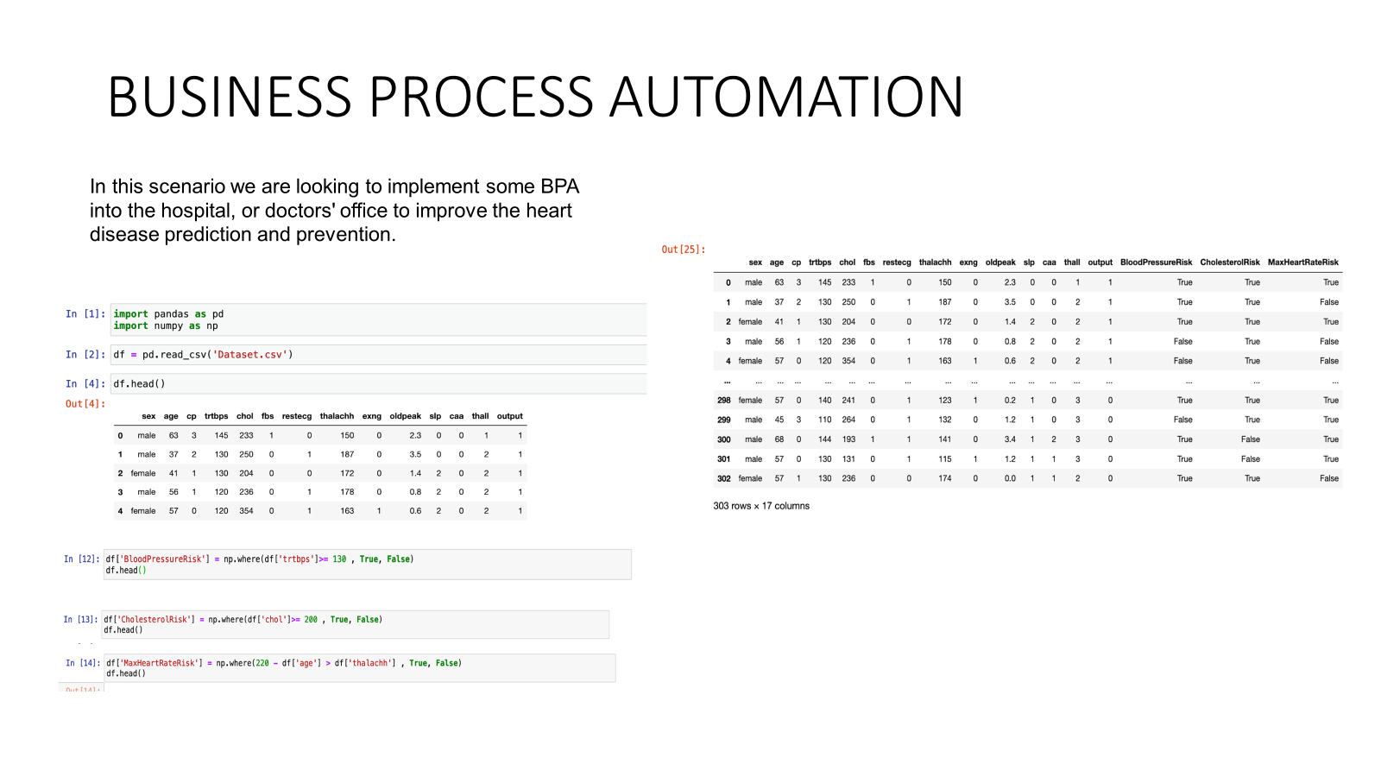

Slide 14
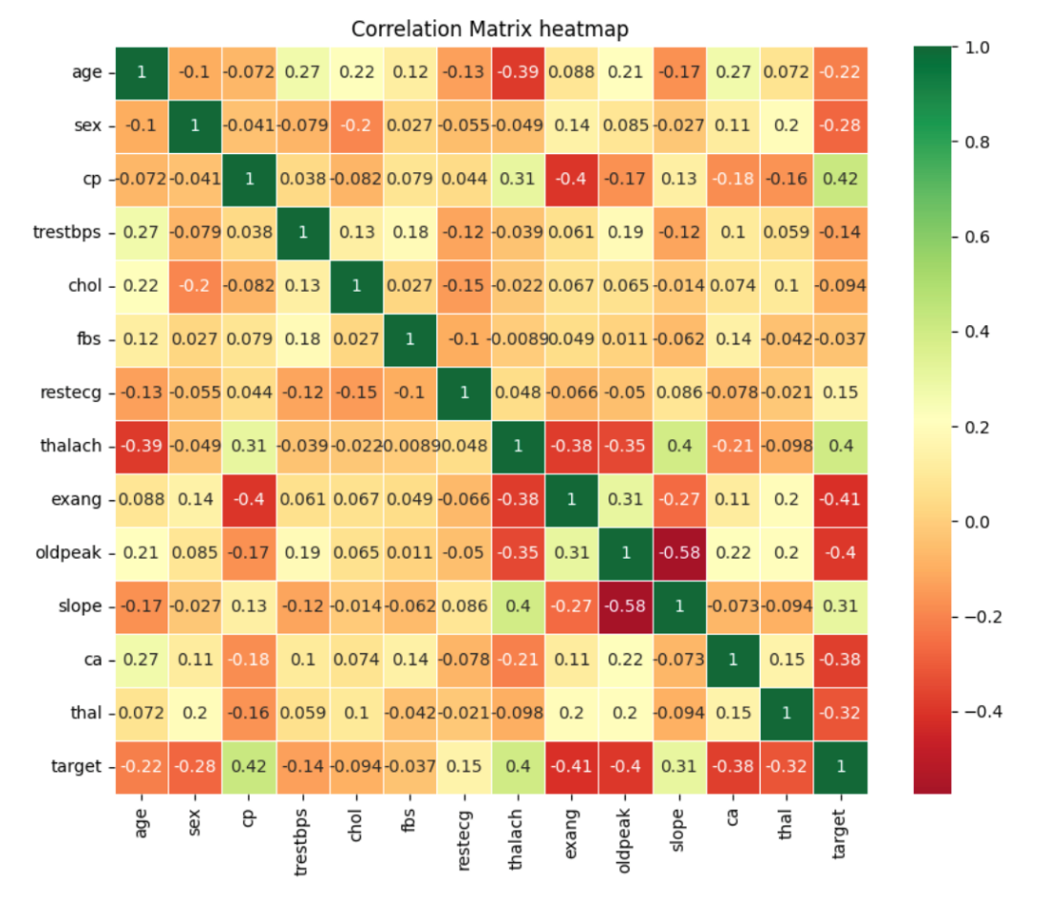
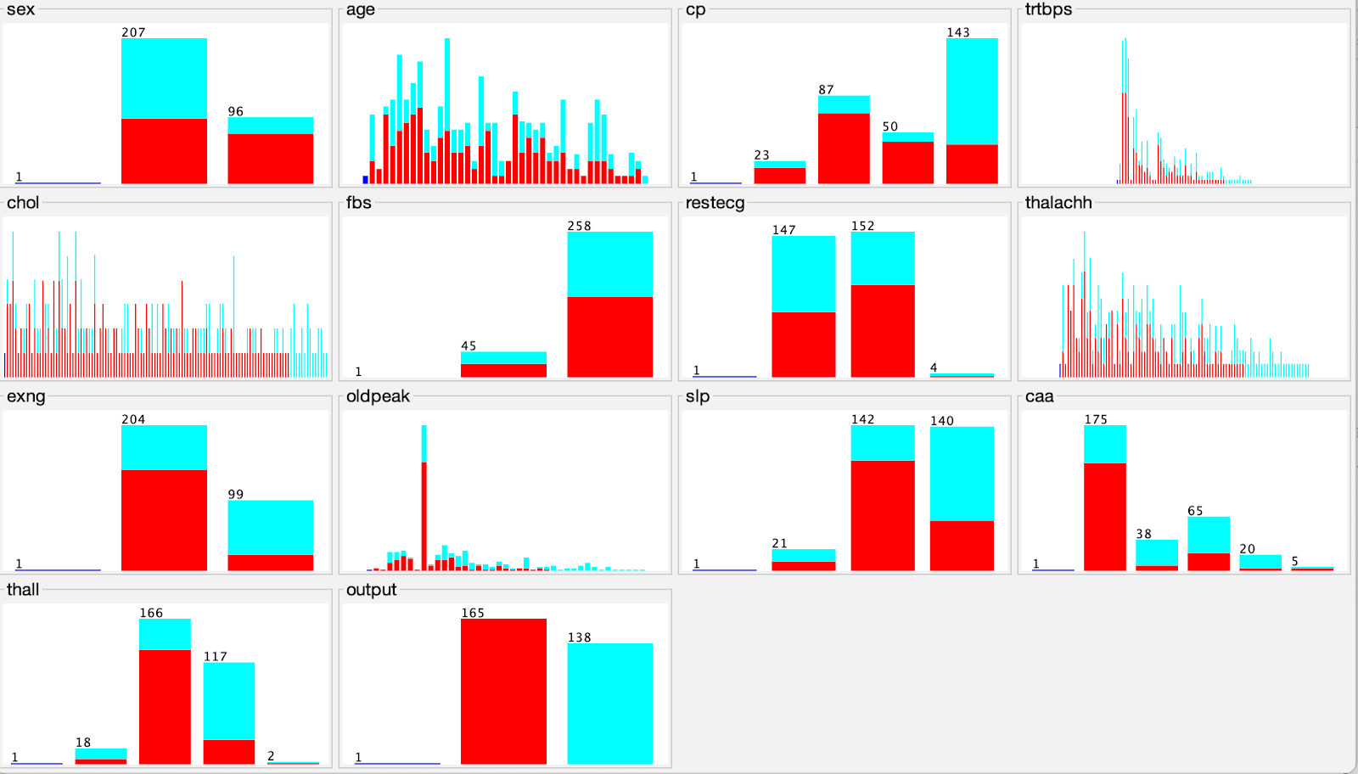
INTRODUCTION TO BUSINESS ANALYTICS
Descriptive Analytics
Diagnostics Analytics

Slide 15
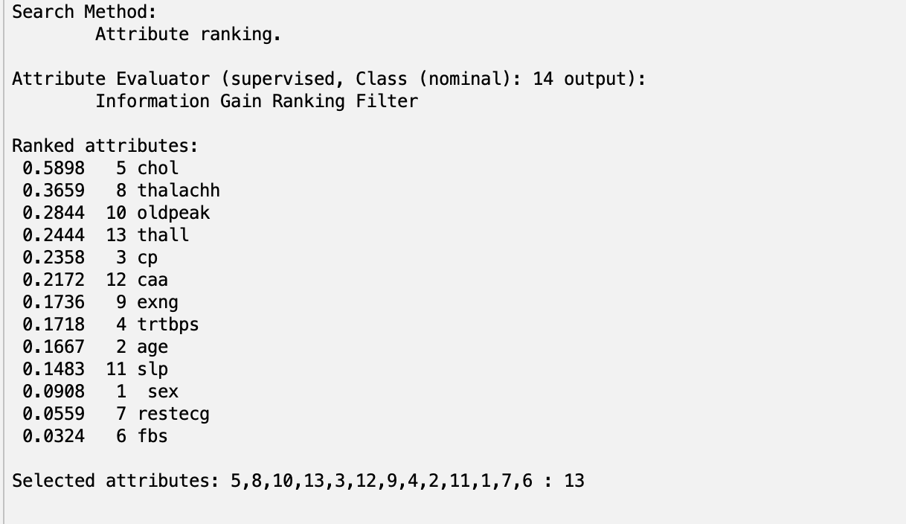
INTRODUCTION TO BUSINESS ANALYTICS (CONTINUED)
Predictive Analytics
Prescriptive Analytics
After analyzing the dataset and understanding the impact of various factors on heart disease, prescriptive analytics aims to identify strategies to reduce the risk of heart attack. Our strategies implement lifestyle modifications by individuals, promotion of community health programs, and utilization of technology to provide ongoing health education and monitoring.
Strategic Recommendations and Implementation
Cholesterol Control
Maximizing Heart Rate Through Exercise
Regular screening and Preventative Measures
Utilizing Technology for Heart Health

Slide 16
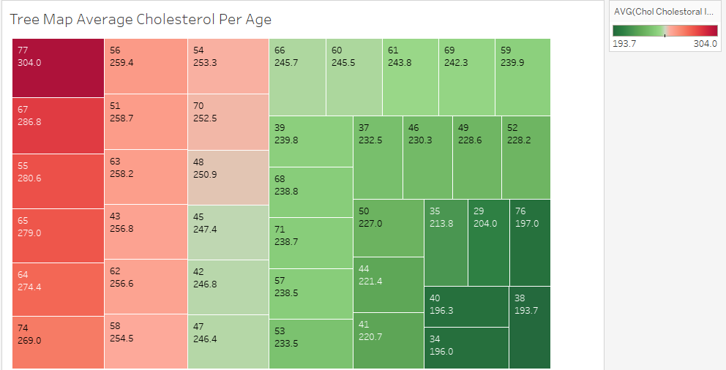
BUSINESS DATA VISUALIZATION
Cholesterol is the most important attribute to predict heart disease.
This tree map is a visualization of the average cholesterol levels across different ages.
The highest highest cholesterol level recorded is for age 77, with a reading of 304.0, indicated by the dark red color.
The lowest cholesterol level was at the age of 38 with 193.7. This is shown in the dark green, denoting healthier average levels.

Slide 17
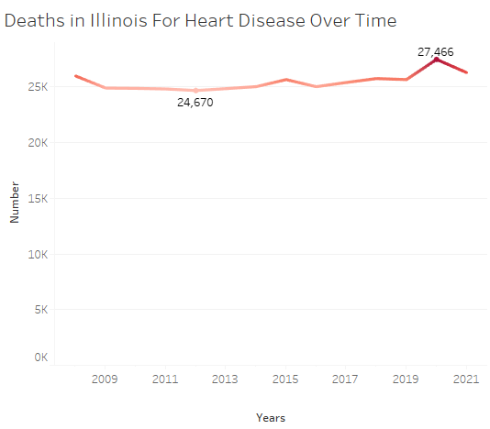
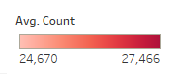
BUSINESS DATA VISUALIZATION (CONTINUED)
Heart Disease is the #1 cause of deaths in the US.
To notice the magnitude of this, a time series visualization was created, it represents the number of deaths due heart disease in Illinois over time.
Lowest death count was in 2012 with 24,670 deaths
Highest death count was in 2020 with 27,466 deaths

Slide 18
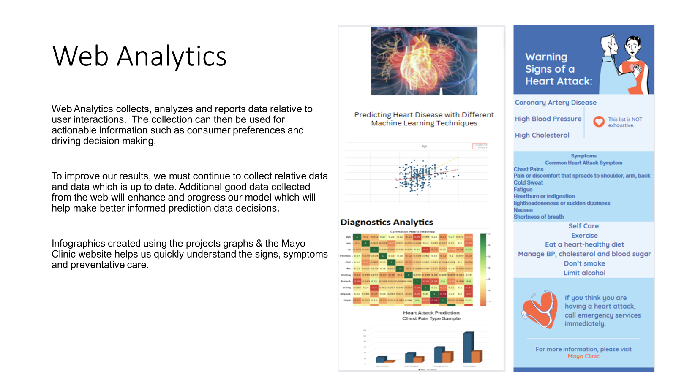
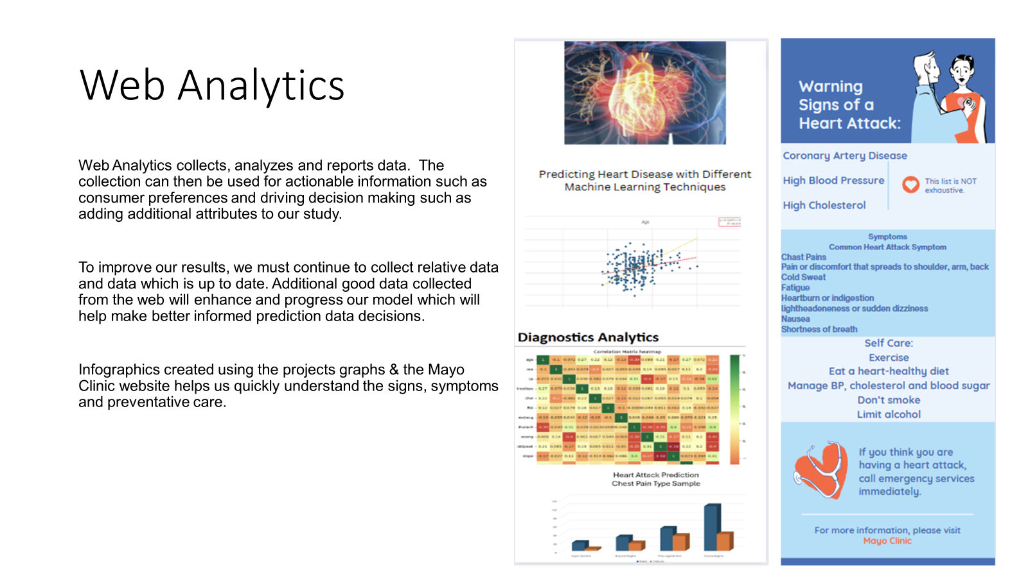

Slide 19
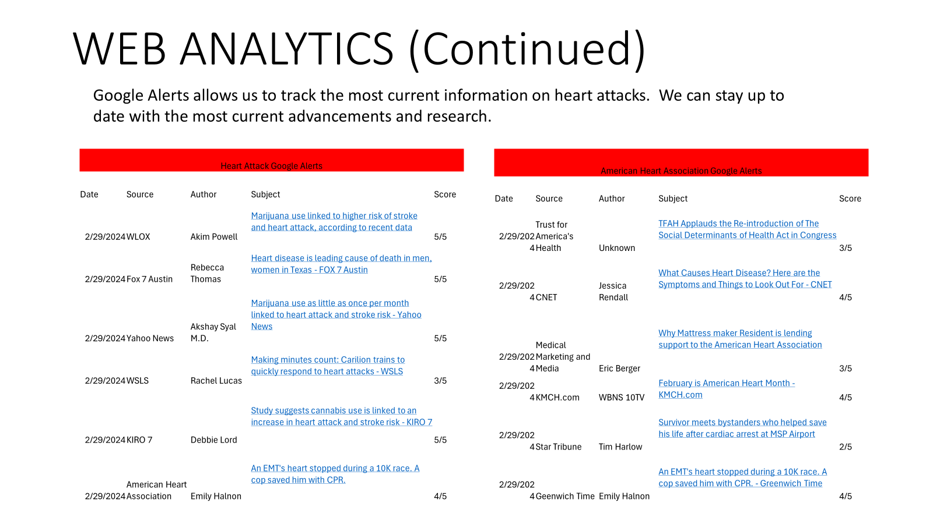

Slide 20
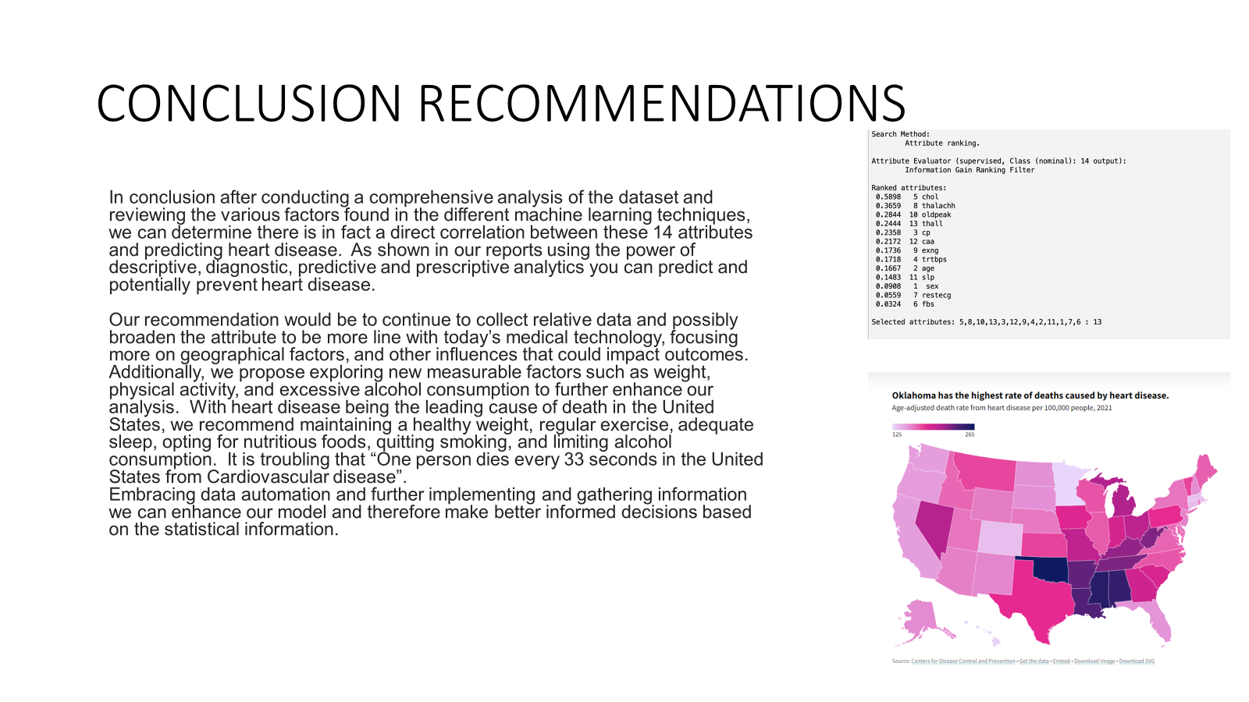

Slide 21
LIMITATIONS
Data is outdated from 1988.
Sample is limited:
Four different databases
303 sample

